Slide 1
Go Microservices

Slide 2
Agenda
What is a Microservice
Introducing protobuf/gRPC
Introduction to the frameworks
Go Microservices with Go kit
Go kit example

Slide 3
What is a Microservice
Microservices is a service-oriented architecture wherein applications are developed as a collection of small autonomous services, modeled around a business domain. Every service in the microservice architecture is self-contained and implements a unique business functionality. Each microservice is responsible for its data model, and microservices can communicate effortlessly through multiple instances. So, failure in one service does not affect the entire application.
In a monolithic architecture, all software components are interconnected and interdependent. If any component or single application’s function fails, the complete application could go down. Imagine you have a web application including functions like payment, history, and log in. If “history” function consumes more memory, the entire application would have to experience the same issue.
Unlike monolithic architecture, microservices break the large software projects into independent, loosely coupled, and smaller modules. In Microservices, the small programs are combined to deliver the functionalities of a large monolithic app.

Slide 4
Introducing protobuf/gRPC
Introduction to Protocol Buffers
Protocol Buffers, also referred as protobuf, is Google’s language-neutral, platform-neutral, extensible mechanism for serializing structured data. Protocol Buffers are smaller, faster, and simpler that provides high performance than other standards such as XML and JSON. By using protocol buffers, you can define your structured data, then you generate source code for your choice of programming language using the protocol buffer compiler named protoc, to write and read your structured data using it. The current version of protocol buffers is proto3. The proto3 version currently supports generated code in variety of languages including C++, Go, Java, Python, Ruby, and C#.

Slide 5
Introducing protobuf/gRPC
Introduction to gRPC
gRPC is a high performance, open-source remote procedure call (RPC) framework that can run anywhere. It enables client and server applications to communicate transparently, and makes it easier to build connected systems. The gRPC framework is developed and open-sourced by Google. Google has been using a lot of the underlying technologies and concepts in gRPC for a long time for their many products including several of Google’s cloud products.
By default, gRPC uses Protocol Buffers as the Interface Definition Language (IDL) and as its underlying message interchange format. Unlike JSON and XML, Protocol Buffers are not just message interchange format, it’s also used for describing the service interfaces (service endpoints). Thus Protocol Buffers are used for both the service interface and the structure of the payload messages. In gRPC, you define services and its methods along with payload messages. Like a typical communication between a client application and a RPC system, a gRPC client application can directly call methods on a remote server as if it was a local object in your client application.

Slide 6
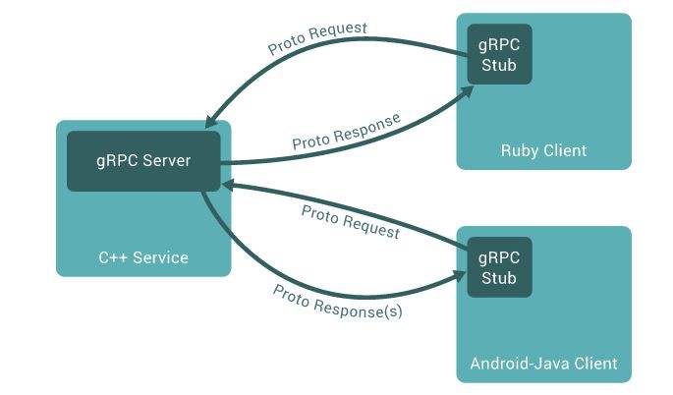
Introducing protobuf/gRPC
communication between a gRPC server and a client application

Slide 7
Introduction to the frameworks
Go Micro.
Go Kit.
Gizmo.
Kite.

Slide 8
Go Micro
It is a pluggable RPC framework for writing microservices in Go. Out of the box, you will receive:
-Service discovery - applications automatically registered with service discovery system.
-Load balancing - client side load balancing used to balance requests between instances of a service.
-Synchronous communication - request/response transport layer provided.
-Asynchronous communication - built in publish/subscribe capabilities.
-Message encoding - encoding/decoding based on Content-Type header of a message.
-RPC Client/Server packages - leverage the above features and expose interface to build microservices.

Slide 9
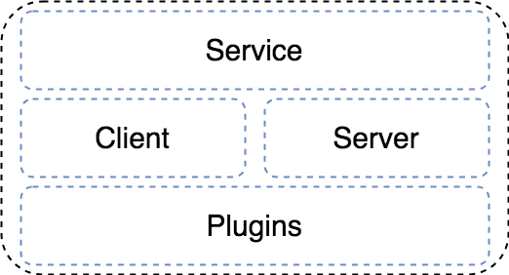
Go Micro
Go Micro architecture can be described as a three layers stack.

Slide 10
Go Micro
The top layers consist of a client-server model and a service abstraction. The server is the building block for writing a service. And the client provides an interface to make requests to services.
The bottom layer consists of plugins of the following types:
-Broker - provides an interface to a message broker for asynchronous pub/sub communication.
-Codec - used for encoding/decoding messages. Supported formats include json, bson, protobuf, msgpack, etc.
-Registry - provides a service discovery mechanism (default is Consul).
-Selector - load balancing abstraction which builds on the registry. It allows services to be “selected” using such algorithms as random, roundrobin, leastconn, etc.

Slide 11
Go Kit
Go Kit is a programming toolkit for building microservices in Go. Unlike Go Micro, it is a library which is designed to be imported to a binary package.
Go Kit follows simple rules such as:
-No global state
-Declarative composition
-Explicit dependencies
-Interfaces as contracts
-Domain driven design
In Go Kit you can find packages for:
-Authentication - basic and JWT.
-Transport - HTTP, Nats, gRPC, and others.
-Logging - generic interface for structured logging in services.
-Metrics - CloudWatch, Statsd, Graphite, and others.
-Tracing - Zipkin and Opentracing.
-Service discovery - Consul, Etcd, Eureka, and others.
-Circuitbreaker - Hystrix implementation in Go.

Slide 12
Gizmo
Gizmo is a microservice toolkit from the New York Times. It provides packages to put together server and pubsub daemons. It exposes the following packages:
-server - offers two server implementations: SimpleServer (over HTTP), RPCServer (over gRPC).
-server/kit - experimental package based on Go Kit.
-config - contains functions to configuration from JSON files, JSON blobs in Consul k/v, or environment variables.
-pubsub - provides generic interfaces for publishing and consuming data from the queues.
-pubsub/pubsubtest - contains test implementations of the publisher and subscriber interfaces.
-web - exposes functions for parsing types from request queries and payloads.
Pubsub package provides interfaces to work with the following queues:
-pubsub/aws - for Amazon SNS/SQS.
-pubsub/gcp - for Google Pubsub.
-pubsub/kafka - for Kafka topics.
-pubsub/http - for publishing via HTTP.

Slide 13
Go Microservices with Go kit
Go kit (http://gokit.io) is a collection of Go packages that help you build robust, reliable, maintainable microservices. Go kit provides libraries for implementing components for system observability and resiliency patterns such as logging, metrics, tracing, rate-limiting and circuit breaking, which are essential requirements for running microservices in production. The good thing about Go kit is that it’s a lightly opinionated, and was designed for interoperability that works with different infrastructures, message encoding formats and transport layers.

